Slide 1

Carteret Public Schools Assessment Presentation
Mrs. Rosa Diaz, Superintendent
Dr. Melissa Jones, Assistant Superintendent
September 25, 2024

Slide 2
Instructional
Administrative Team
Carteret High School
Ms. Joanna Joaquin, Principal
Ms. Jackie DePasquale, Assistant Principal
Mr. Byron Hamby, Assistant Principal
Carteret Jr. High School
Mrs. Tara Romero, Principal
Mr. Chris Tullo, Assistant Principal
Carteret Middle School
Ms. Merita Euell, Principal
Mr. Jihad Jubran, Assistant Principal
Elementary School
Mrs. Cheryl Bolinger, Principal- Minue
Ms. Erika Barrett, Principal- Nathan Hale
Ms. Chris Rozanski, Assistant Principal
Ms. Mayling Cardenas, Principal - Columbus
Dr. Karen Jones, Assistant Principal
Mrs. Josephine Wilson, Director of Curriculum & Instruction
Mr. Christian Zimmer, Director of Data, Evaluation, and Assessment
Mr. Sean Powers, Director of STEM
Mrs. Sue Cherney, Director of Special Services
Mrs. Michelle Jonte, Director of ESL, Bilingual, WL
Mrs. Sweety Patel, Director of Guidance
Mrs. Grace Cunha, Director of Athletics, Supervisor PE/Health

Slide 3
2023-2024
NJSLA Results

Slide 4

NJSLA Performance Levels
NJSLA uses five performance levels to determine student attainment of grade level expectations
Level 1 | Level 2 | Level 3 | Level 4 | Level 5
Not yet meeting grade-level expectations | Partially meeting grade-level expectations | Approaching grade-level expectations | Meeting grade-level expectations | Exceeding grade-level expectations

Slide 5
NJSLA 23-24 Analysis
Test | EE | ME | PME | AE | DNM | 23-24 % Passing | 22-23% Passing
Grade 3 ELA | 1% | 33% | 25% | 13% | 27% | 34% | 26.%
Grade 3 Math | 5% | 29% | 29% | 22% | 25% | 34% | 34.%
Grade 4 ELA | 2% | 35% | 24% | 21% | 19% | 37% | 42.%
Grade 4 Math | 2% | 29% | 28% | 26% | 14% | 31% | 29.%
Grade 5 ELA | 7% | 27% | 26% | 16% | 14% | 44% | 38.%
Grade 5 Math | 2% | 26% | 30% | 26% | 16% | 28% | 23.%
Grade 6 ELA | 7% | 32% | 27% | 19% | 15% | 39% | 38.%
Grade 6 Math | 1% | 19% | 27% | 29% | 24% | 20% | 21.%
Grade 7 ELA | 15% | 26% | 23% | 17% | 19% | 41% | 42.%
Grade 7 Math | 2% | 21% | 29% | 33% | 15% | 23% | 15.%
Grade 8 ELA | 9% | 37% | 22% | 16% | 16% | 46% | 39.%
Grade 8 Math | 0% | 12% | 23% | 32% | 34% | 12% | 9.%
Grade 9 ELA | 10% | 29% | 21% | 18% | 23% | 39% | 37.%
Alg. 1 | 1% | 24% | 24% | 33% | 18% | 25% | 17.%
Gr 7 & 8 Alg 1 | 3% | 76% | 14% | 7% | 0% | 79% | 62.%
Gr 9-12 Alg 1 | 0% | 9% | 27% | 40% | 23% | 9% | 5%
Geom | 0% | 32% | 43% | 17% | 8% | 32% | 32%
Gr 8 Geo | 0% | 59% | 35% | 6% | 0% | 59% | 63.%
Gr 9-12 Geo | 0% | 10% | 49% | 27% | 15% | 10% | 4.60%
Alg. 2 | 0% | 26% | 37% | 22% | 16% | 26% | 17.%

Slide 6
NJSLA ELA

Slide 7
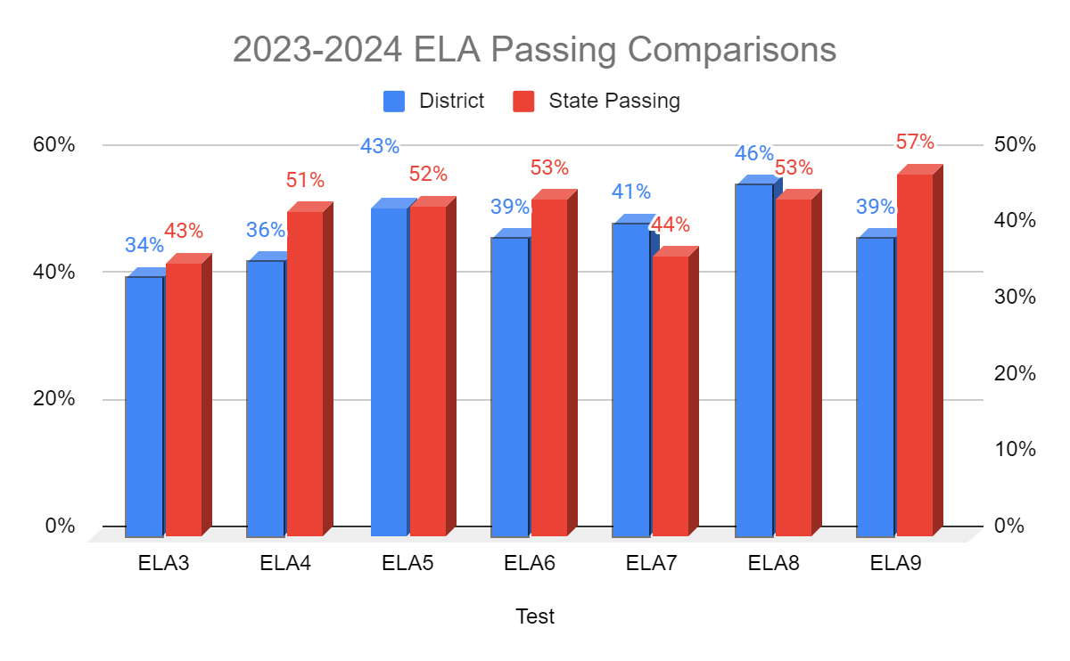

Slide 8
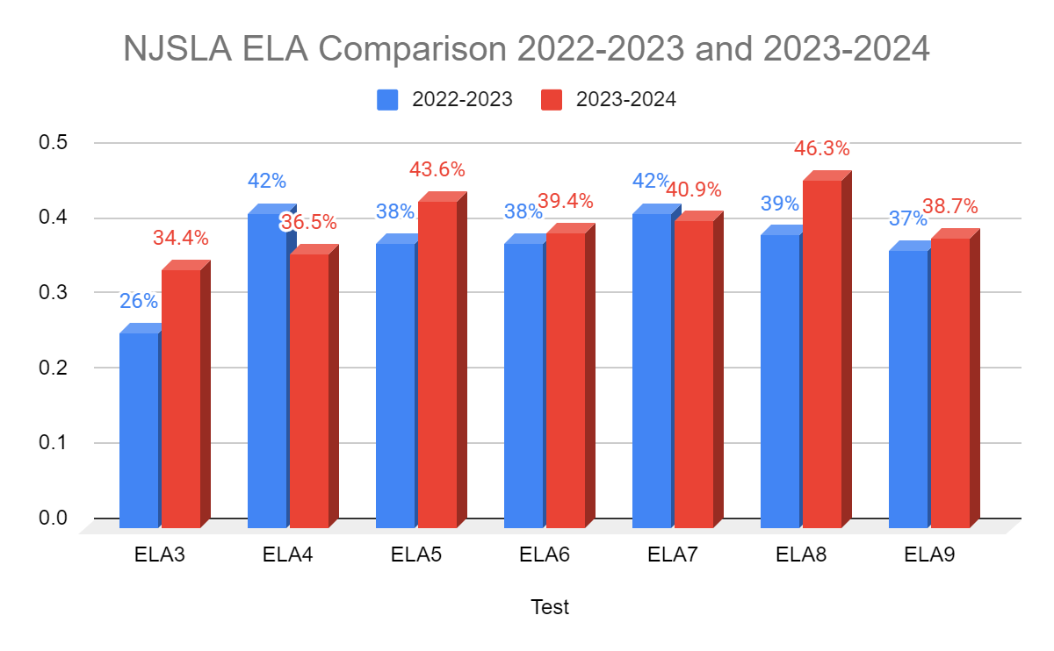

Slide 9
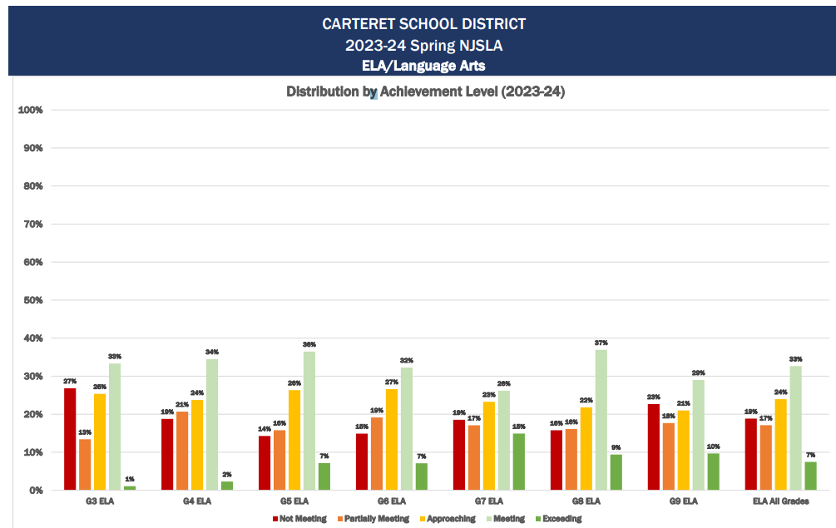

Slide 10
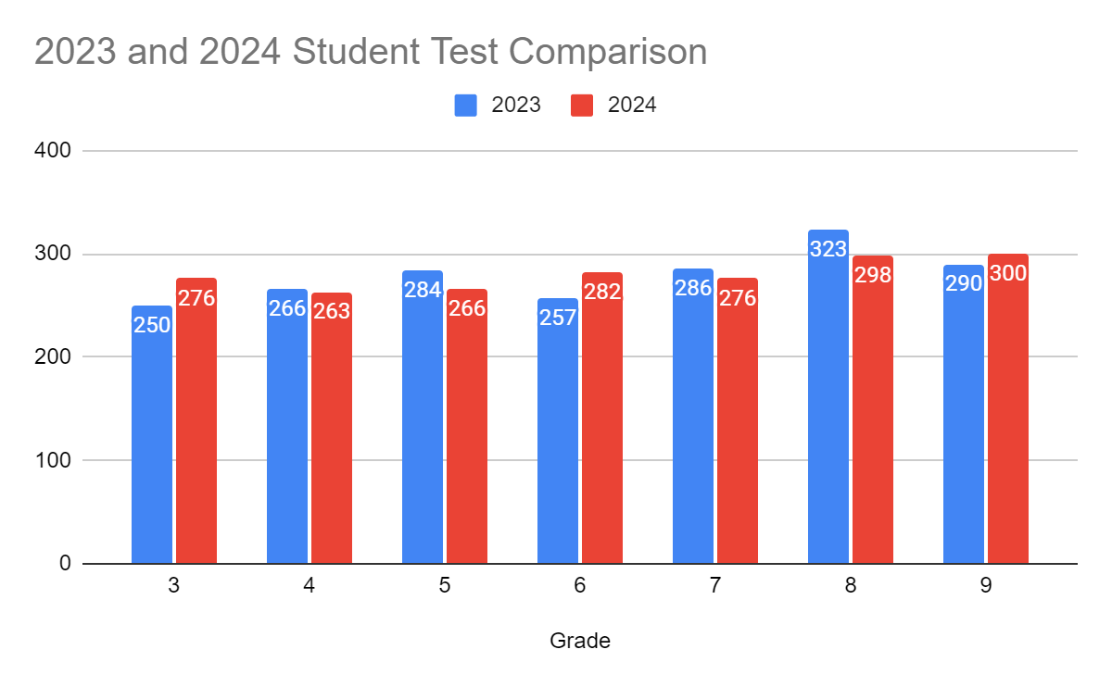
Comparison of Carteret Public School’s Spring 2023 and 2024 NJSLA Administrations ELA – Student Tested
Grade | 2023 | 2024
3 | 250 | 276
4 | 266 | 263
5 | 284 | 266
6 | 257 | 282
7 | 286 | 276
8 | 323 | 298
9 | 290 | 300

Slide 11
ELA Next Steps

Slide 12
NJSLA Math

Slide 13
Grade 8 data: Some students in grade 8 participated in the Algebra I assessment in place of the 8th grade Math assessment. Thus, Math 8 outcomes are not representative of grade 8 performance as a whole.
Algebra 1, 2 and Geometry data: Students in grades 11 and 12 were not included.
Percentages may not total 100 due to rounding.

Slide 14
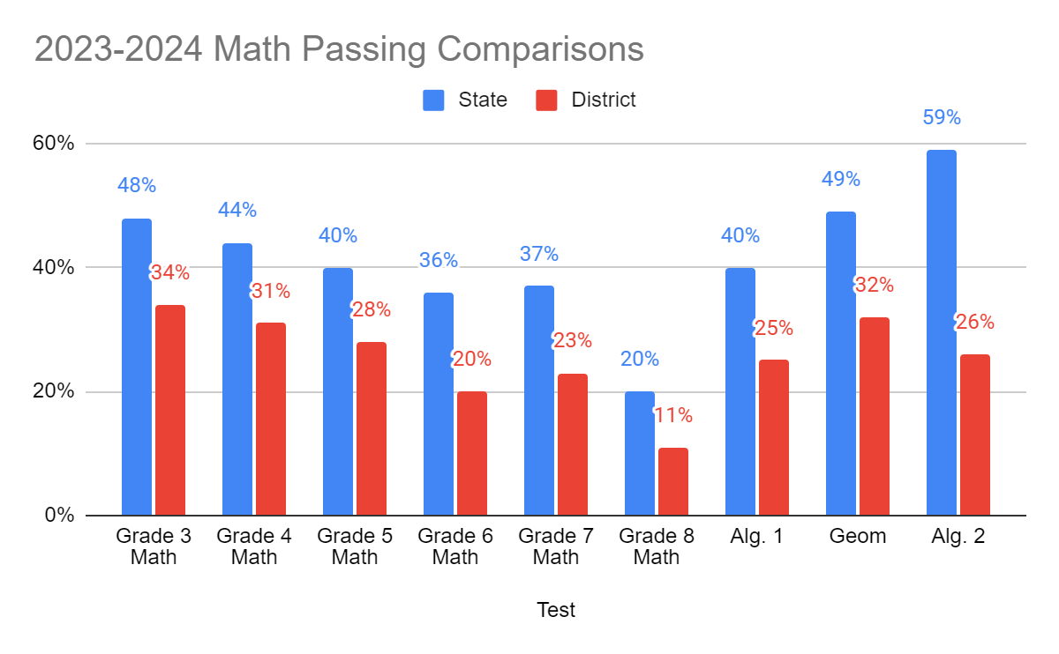

Slide 15
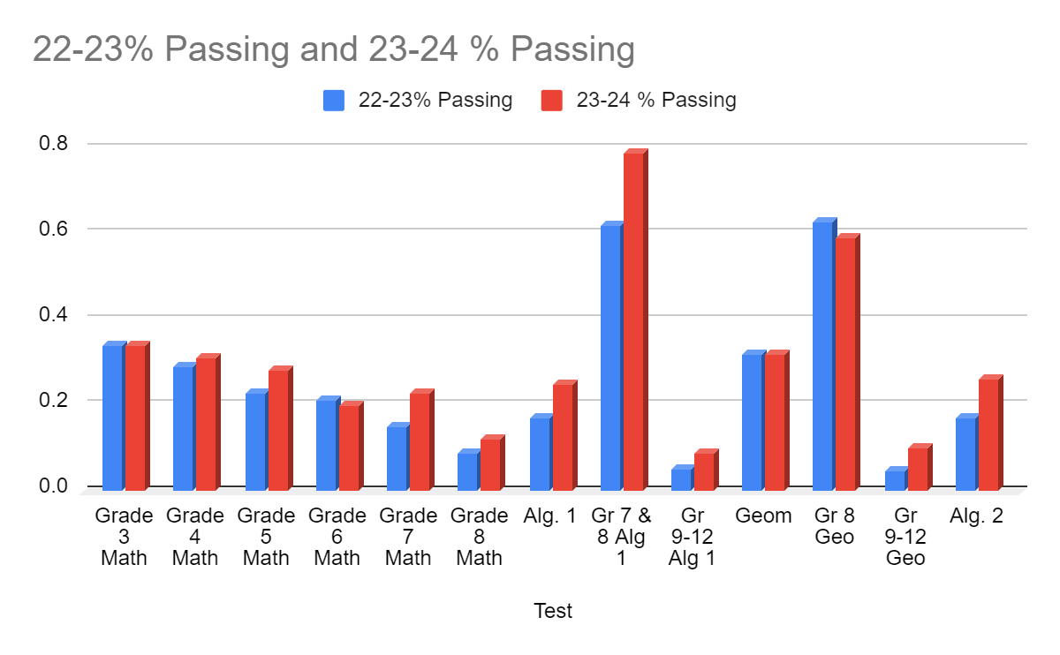
NJSLA Math 2023 to 2024 Growth

Slide 16
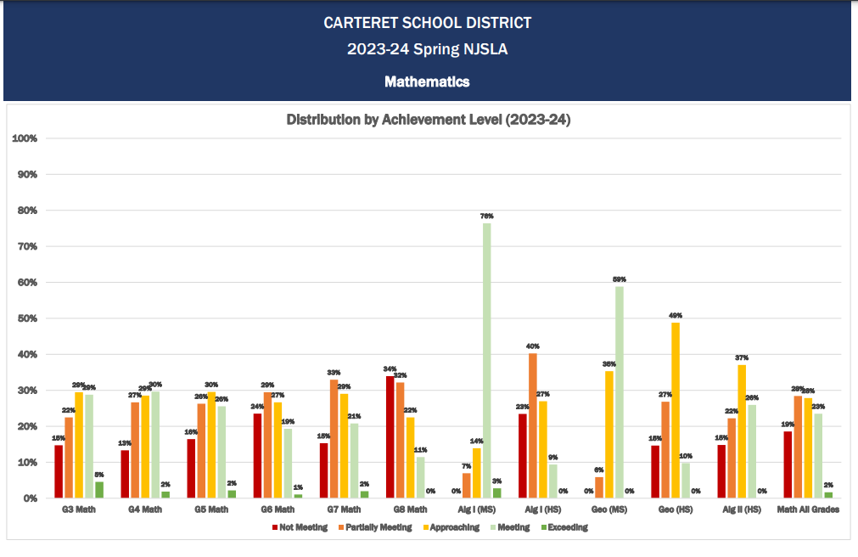

Slide 17
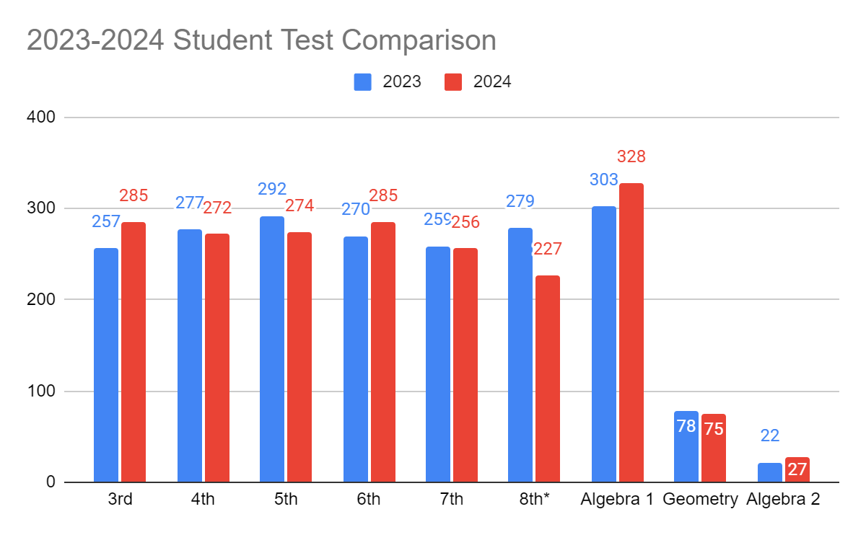
Comparison of Carteret Public School’s Spring 2023 and 2024 NJSLA Administrations Math – Students Tested
Grade | 2023 | 2024
3 | 257 | 285
4 | 277 | 272
5 | 292 | 274
6 | 270 | 285
7 | 259 | 256
8* | 279 | 227
Algebra 1 | 303 | 328
Geometry | 78 | 75
Algebra 2 | 22 | 27

Slide 18
Math Next Steps

Slide 19
NJSLA Science

Slide 20
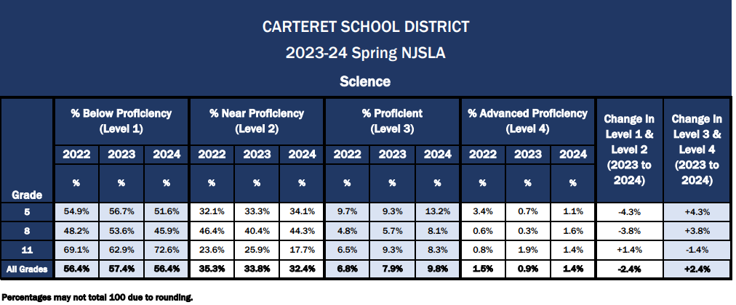
Comparison of Carteret Public School’s Spring 2022 and 2023 NJSLA Administrations Science – Percentages

Slide 21
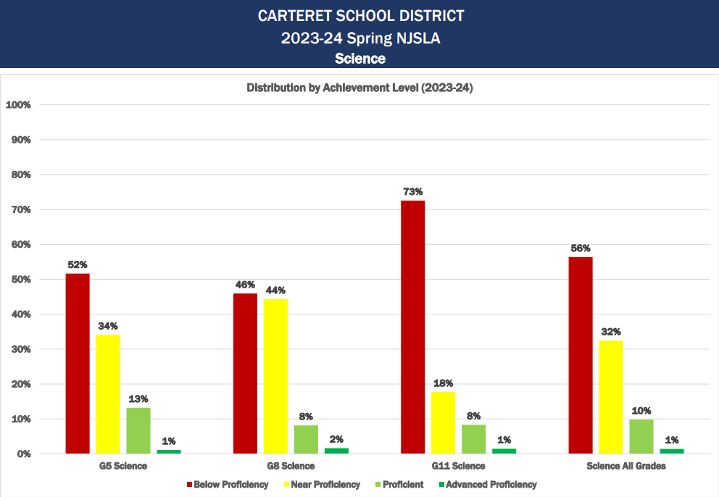

Slide 22
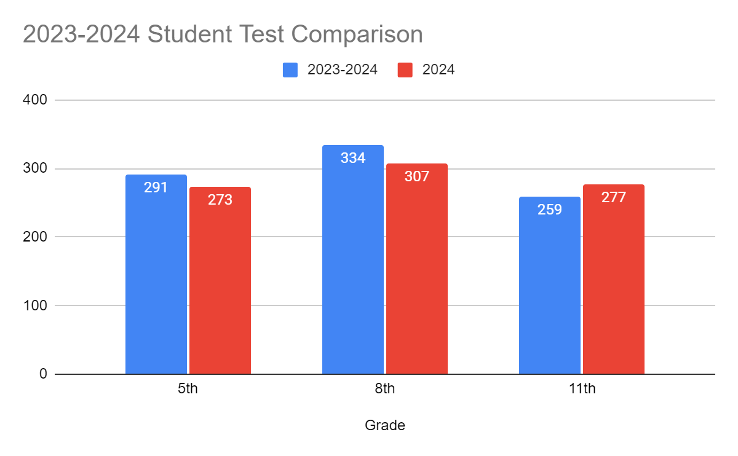
Comparison of Carteret Public School’s Spring 2022 and 2023 NJSLA Administrations Science – Student Tested
Grade | 2023 | 2024
5 | 291 | 273
8 | 334 | 307
11 | 259 | 277

Slide 23
Science Next Steps

Slide 24
NJSLA
School Comparison

Slide 25
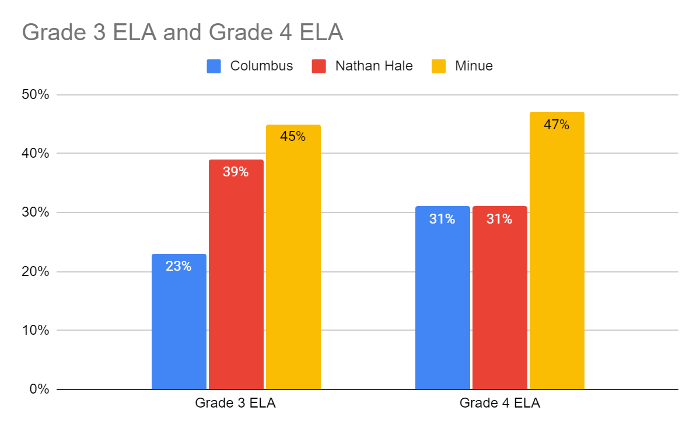
Carteret Public School’s Spring 2024 NJSLA School & Grade-Level Comparison ELA Proficiency Percentages
Notes:
Grade 3 ELA
Col: 19%
Nathan Hale: 21%
Minue: 37%
Grade 4 ELA
Col: 39%
Hale: 37:
Minue 47%

Slide 26
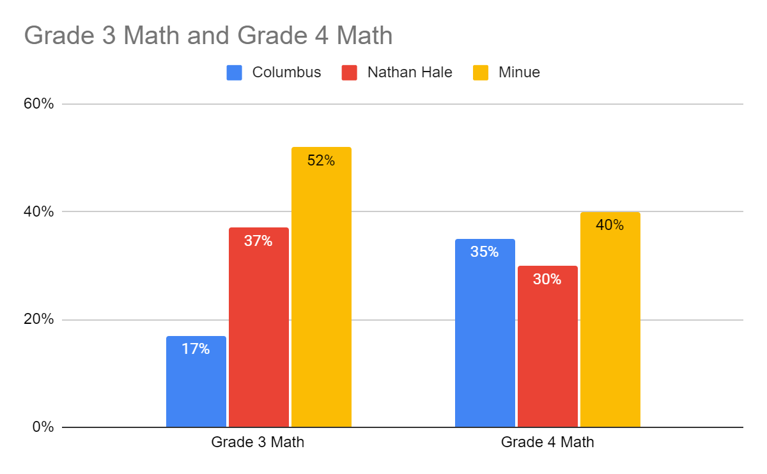
Carteret Public School’s Spring 2024 NJSLA School & Grade-Level Comparison Math Proficiency Percentages
Notes:
Grade 3 ELA
Col: 19%
Nathan Hale: 21%
Minue: 37%
Grade 4 ELA
Col: 39%
Hale: 37:
Minue 47%

Slide 27
NJSLA
Demographic Data
Subgroup

Slide 28
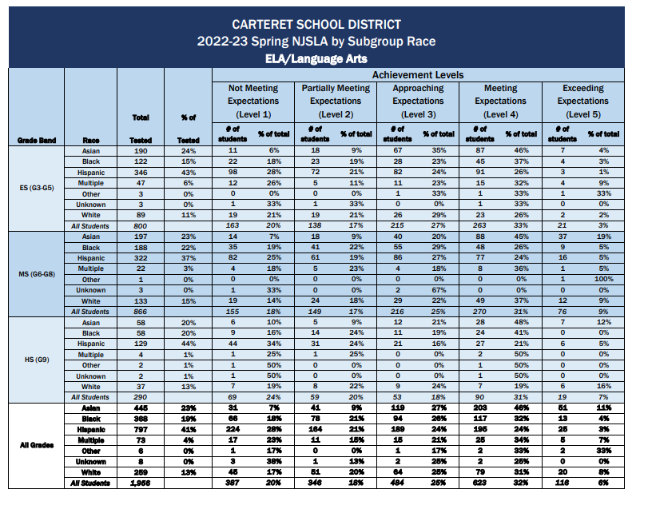

Slide 29
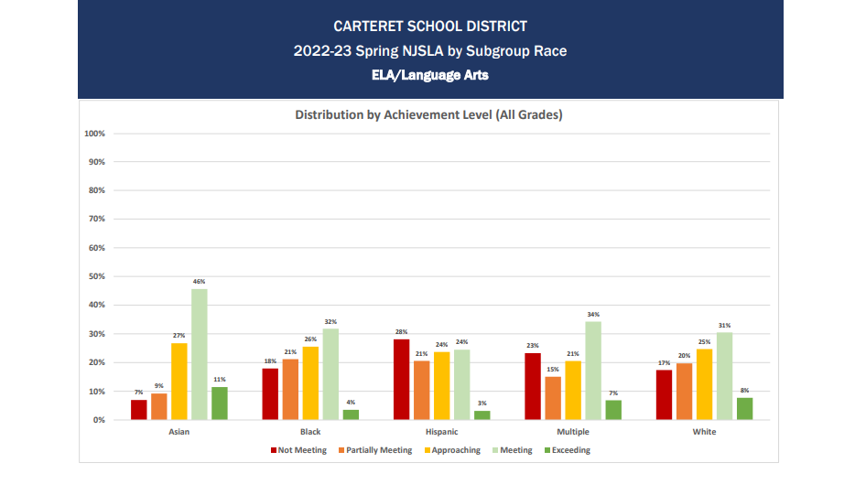

Slide 30
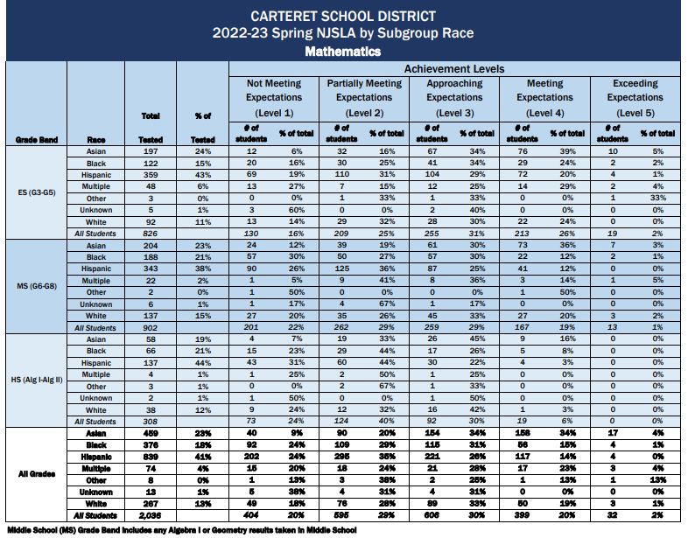

Slide 31
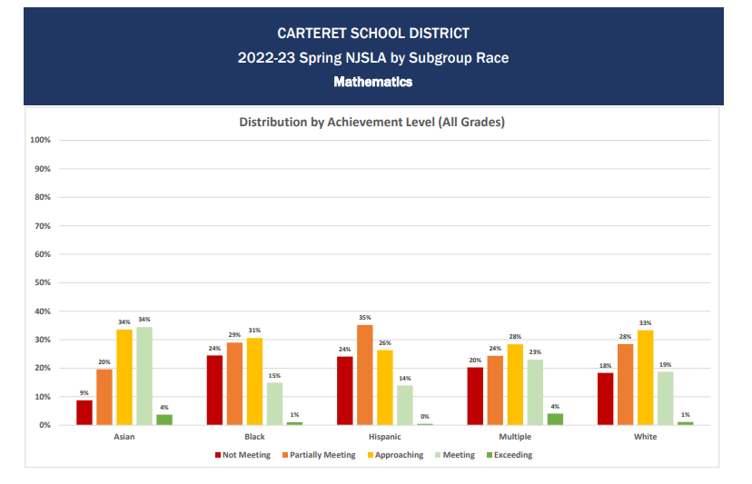

Slide 32
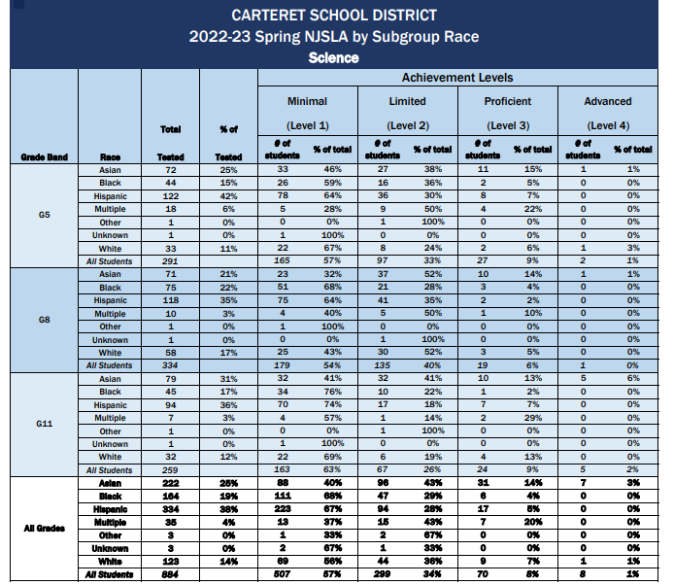

Slide 33
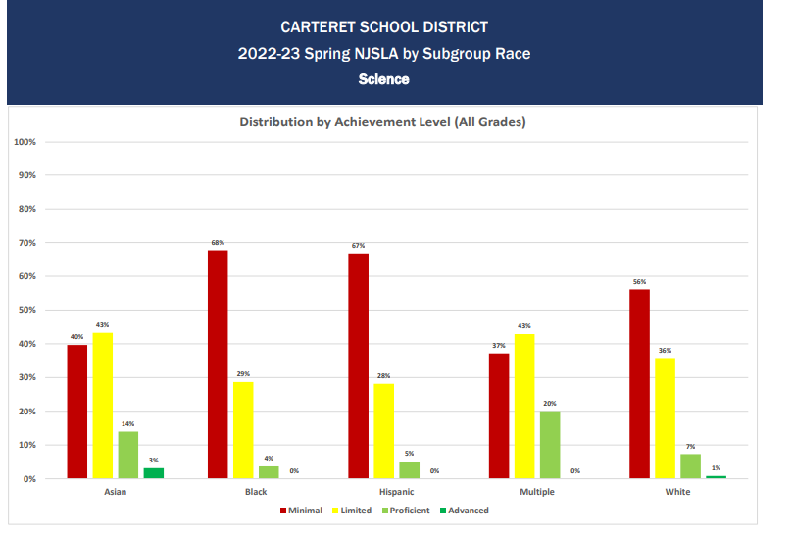

Slide 34
NJSLA
Demographic Data
Gender

Slide 35
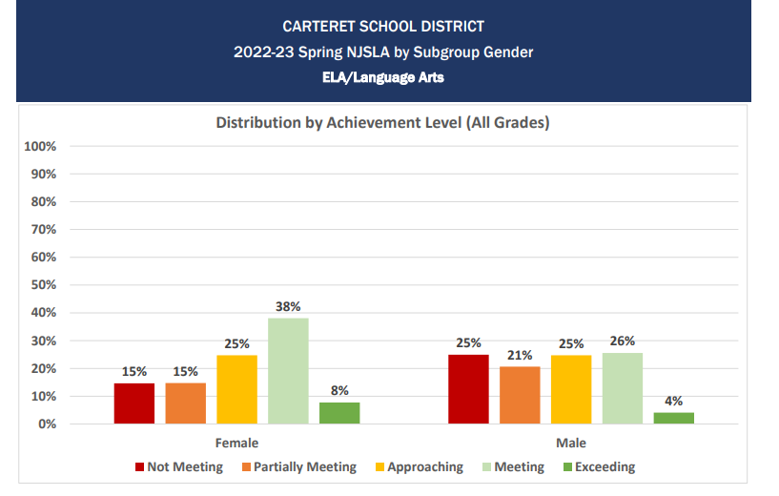
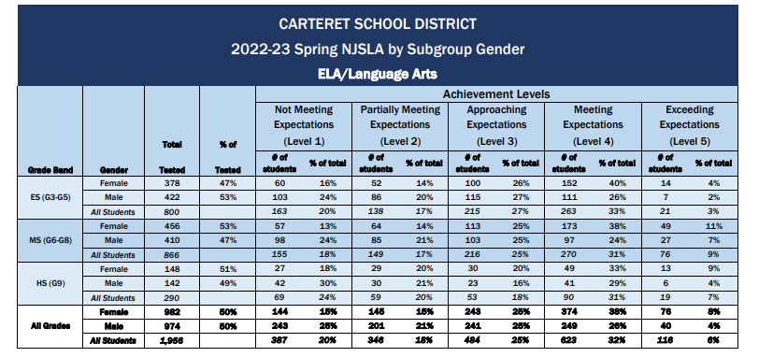
ELA

Slide 36
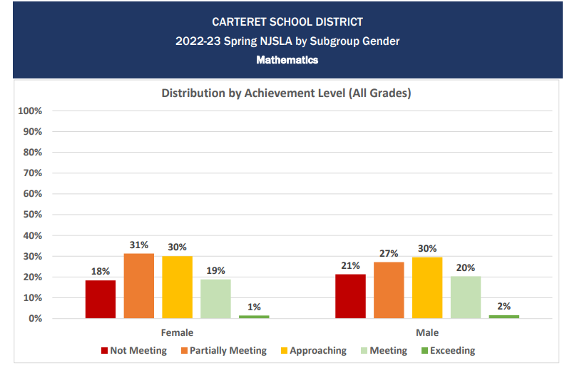
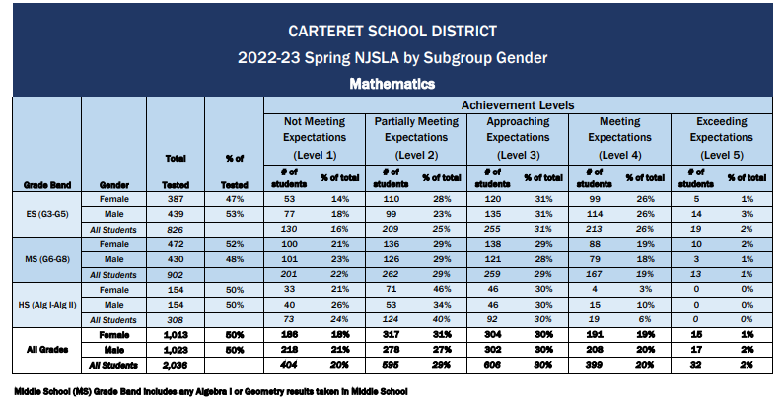
Math

Slide 37
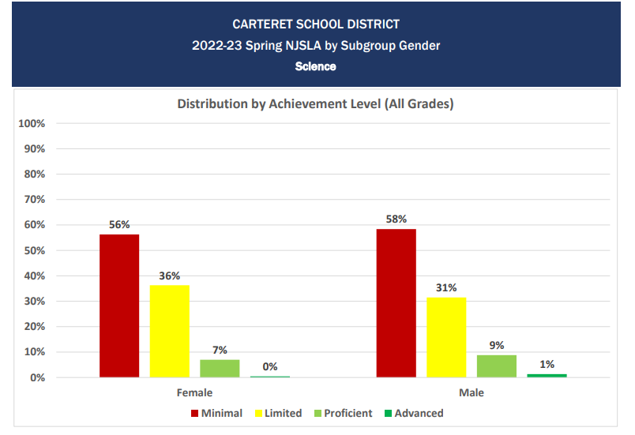
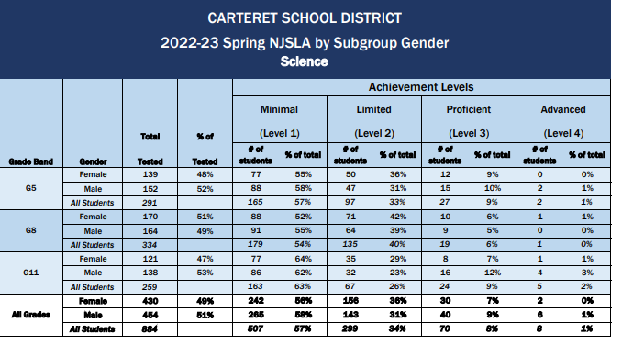
Science

Slide 38
NJSLA
Demographic Data
Program

Slide 39
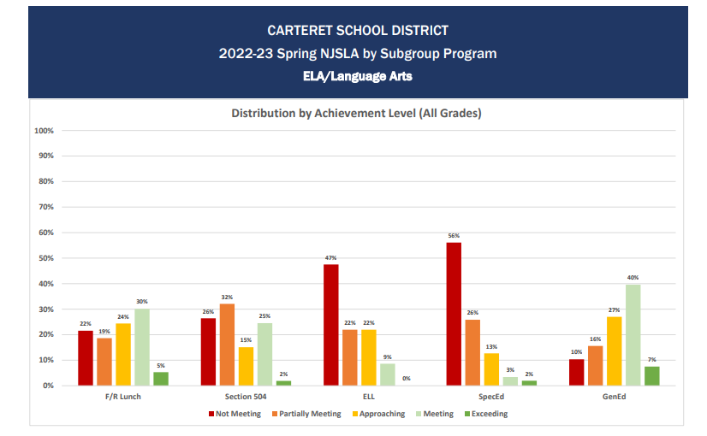
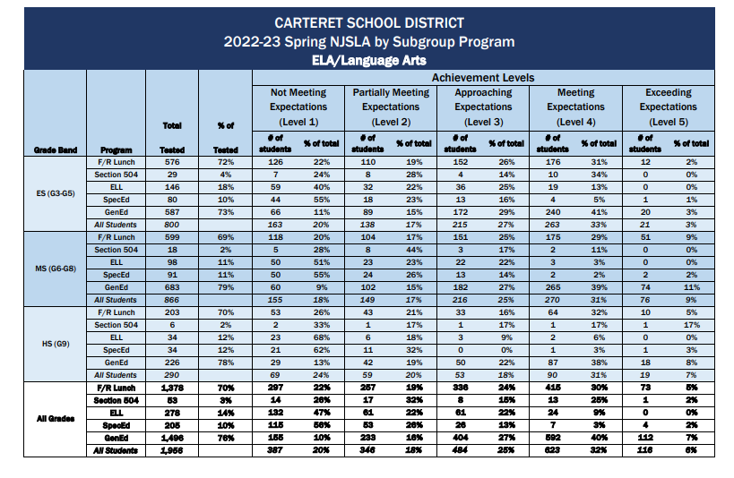
ELA

Slide 40
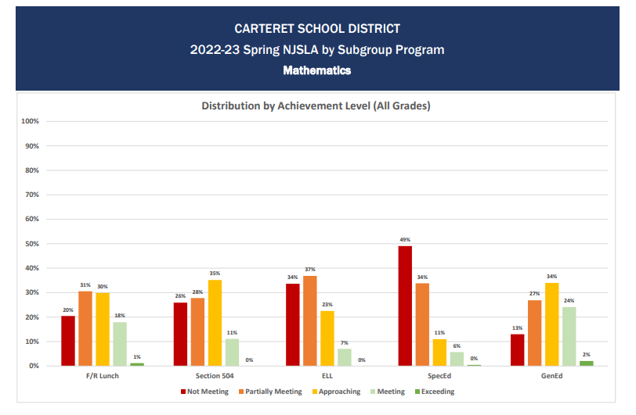
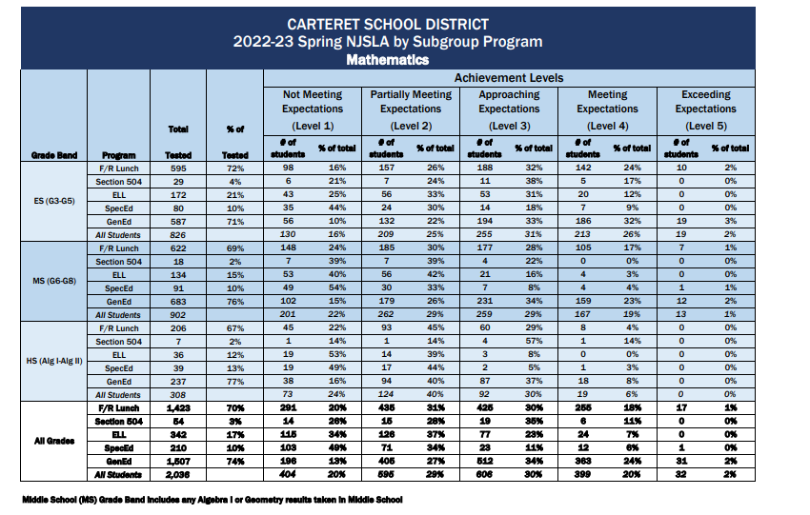
Math

Slide 41
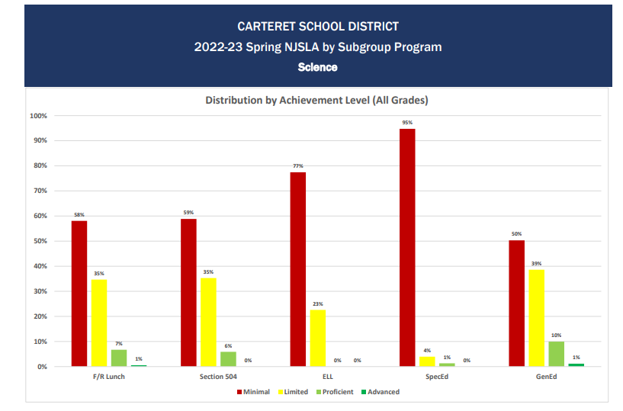
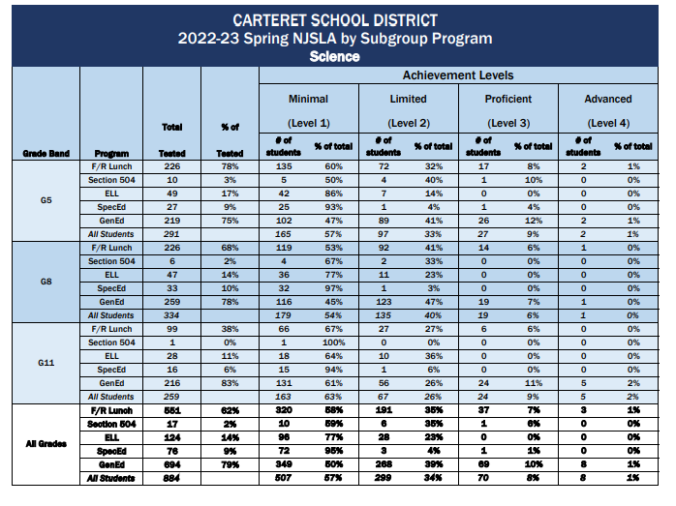
Science

Slide 42
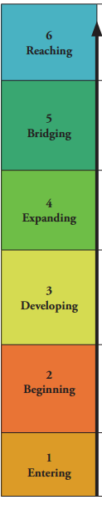
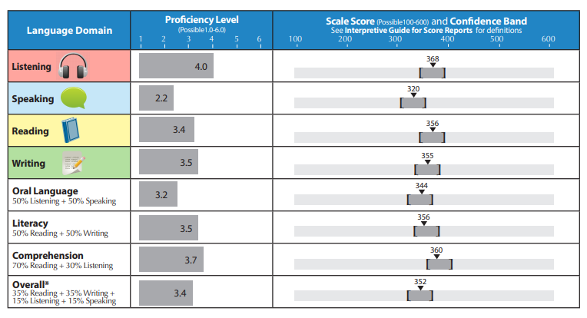
WIDA Scores
English Language Progress to Proficiency
At this time we have not received NJDOE date to determine if our English Language learners have met their expected amount of growth in the ACCESS for English Language Proficiency

Slide 43
2023-2024 DLM Data
Students Administered the DLM
In District Out of District
Language Arts In District
Emerging 1 Approaching
At Target Advanced
Math In District
Emerging Approaching
At Target Advanced
Science In District
Emerging Approaching
At Target Advanced

Slide 44
2023-2024 Seal of Biliteracy
2024 Seniors who attained the Seal of Biliteracy: 26
2024 Juniors who passed the Seal of Biliteracy: 14
Languages:
Spanish, Urdu
Punjabi, German
French, Portuguese
Hindi, Bengali, Dutch

Slide 45
2023-2024 AP Scores
AP Test | # of 3 scores | # of 4 scores | # of 5 scores
Biology | 6 | 1 | 0
Calculus AB | 8 | 3 | 0
Computer Science A | 3 | 0 | 0
Computer Science Principles | 0 | 1 | 0
English Lang & Comp | 2 | 0 | 0
English Lit & Comp | 12 | 5 | 0
Environmental Science | 3 | 2 | 0
Human Geography | 3 | 0 | 0
Physics 1 | 1 | 0 | 0
Psychology | 12 | 1 | 2
Spanish Lang & Cult
Statistics | 1 | 0 | 0
US History | 1 | 3 | 0

Slide 46


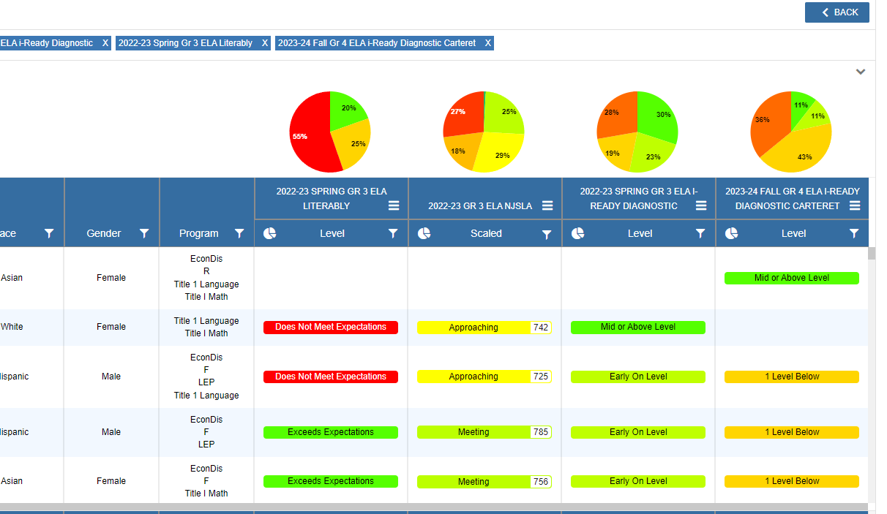


Local Assessment Data

Slide 47
2023-2024 PSAT National Recognition
Jasiel Amigon - First Generation, Hispanic
Anisah Brown - African American, First Generation
Eleesha Burton - African American
Satnam Dhaliwal - First Generation
Stephania Pena-Colorado - Hispanic
Lucas Rios - First Generation, Hispanic

Slide 48
Thank you!

